Slide 1

Monitoring & Analytics

Slide 2

Business KPIs exposed from products
ESB statistics
Mediation stats
API/Proxy stats
Message specific stats (files processed / messages processed)
Error stats (endpoint stats)
API Manager Statistics
API invocation stats
Who is using the APIs
Useage stats
Message broker statistics
Number of messages in the queue
Message rate (enqueue / dequeue)

Slide 3
Gathering operational data / stats (via JMX / Logs)
Memory usage information
Processing power / usage
Java thread information
Number of errors
Backend errors vs client side errors

Slide 4
Use of third party tools
Methods to integrate with
Via SOAP admin services
Via JMX
Via logs

Slide 5
Use of WSO2 Data Analytics Server (DAS)
ESB, API-M and MB all has customer dashboards in DAS
All products can push their business and operation stats to DAS
DAS has OOTB summarization queries to get information out of raw data
DAS can connect with multiple protocols

Slide 6
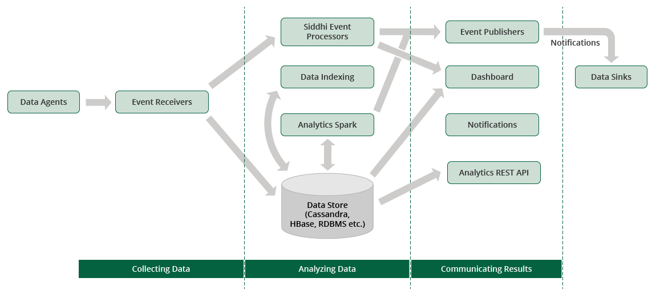
DAS architecture

Slide 7
Batch, real time, interactive analytics
When to use batch
Historic data summarization
Trend analysis
Correlation
Pre-defined KPIs
When to use real time
Configuring alerts
Perform an action based on a trend or an event
When to use interactive
When KPIs are not defined
When summarization is needed on demand.

